Slide 1
Programming with Python

Slide 2
Objectives
History
Significance
Installing & Running Python
Simple script examples
Guide to Programming with Python

Slide 3
Brief History of Python
Invented in the Netherlands, early 90s by Guido van Rossum
Named after Monty Python
Open sourced from the beginning, man-aged by Python Software Foundation
Considered a scripting language, but is much more
Scalable, object oriented and functional from the beginning
Used by Google from the beginning

Slide 4

Python’s Benevolent Dictator For Life
“Python is an experiment in how much freedom program-mers need. Too much freedom and nobody can read another's code; too little and expressive-ness is endangered.”
- Guido van Rossum

Slide 5
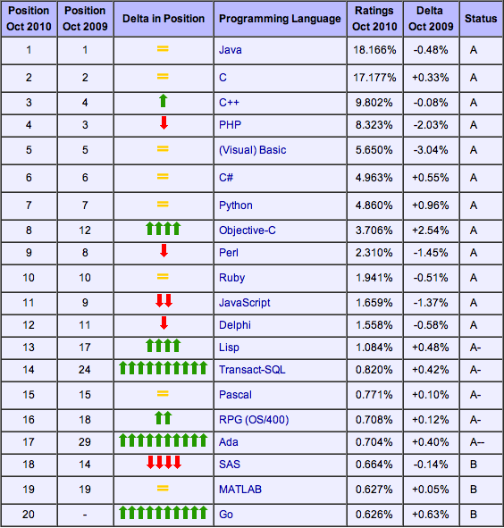
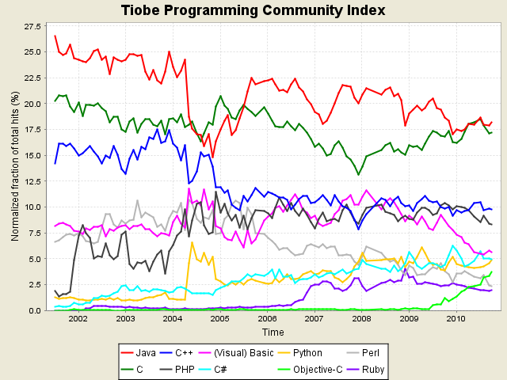
Python’s place in the Market
TIOBE has been collecting data on programming language “popularity” for many years
Counts results for a query like "<language> programming” on popular search engines
10/10 TIOBE Programming Community Index

Slide 6
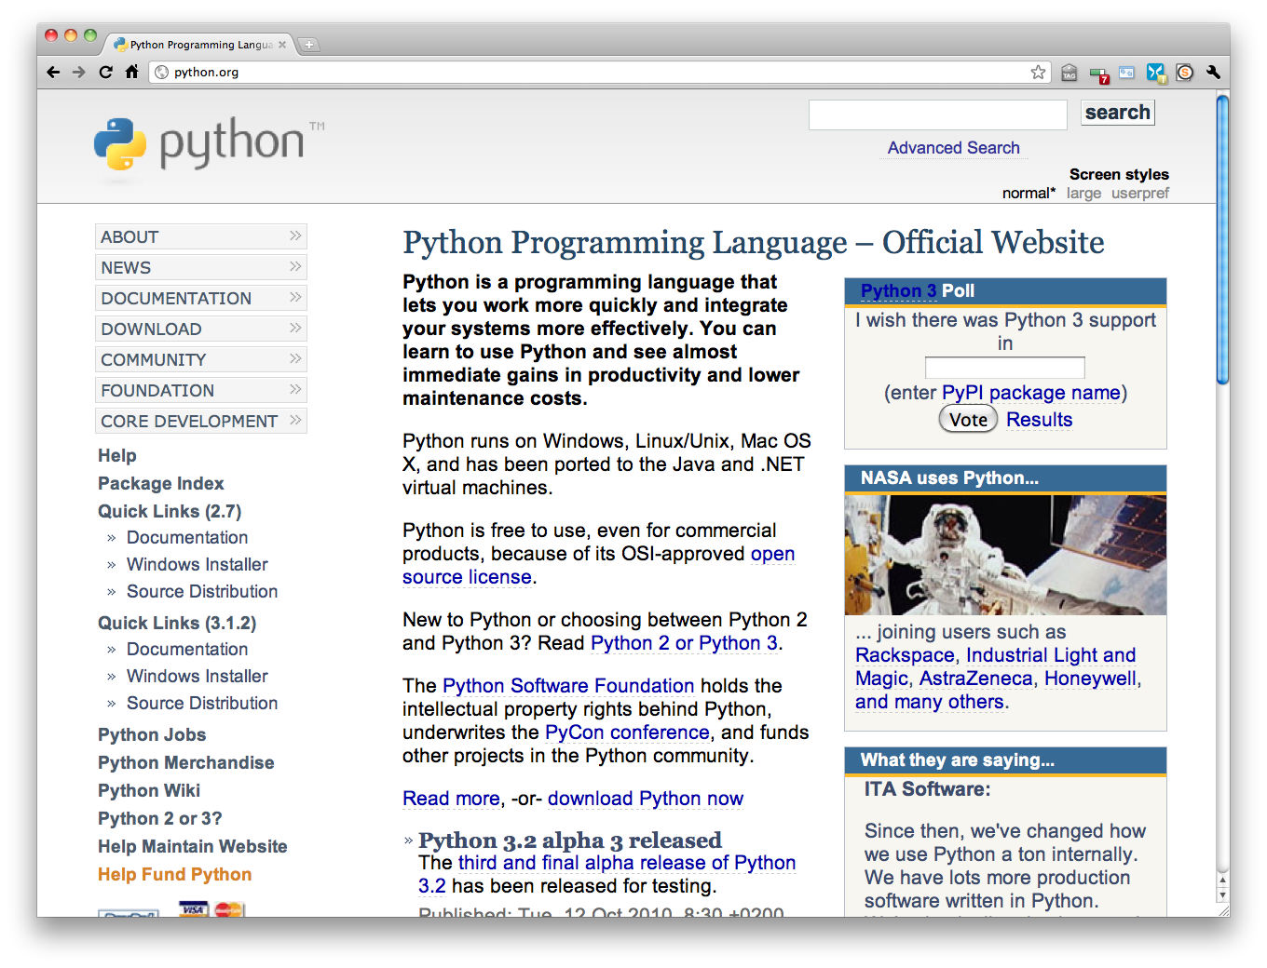
http://python.org/

Slide 7
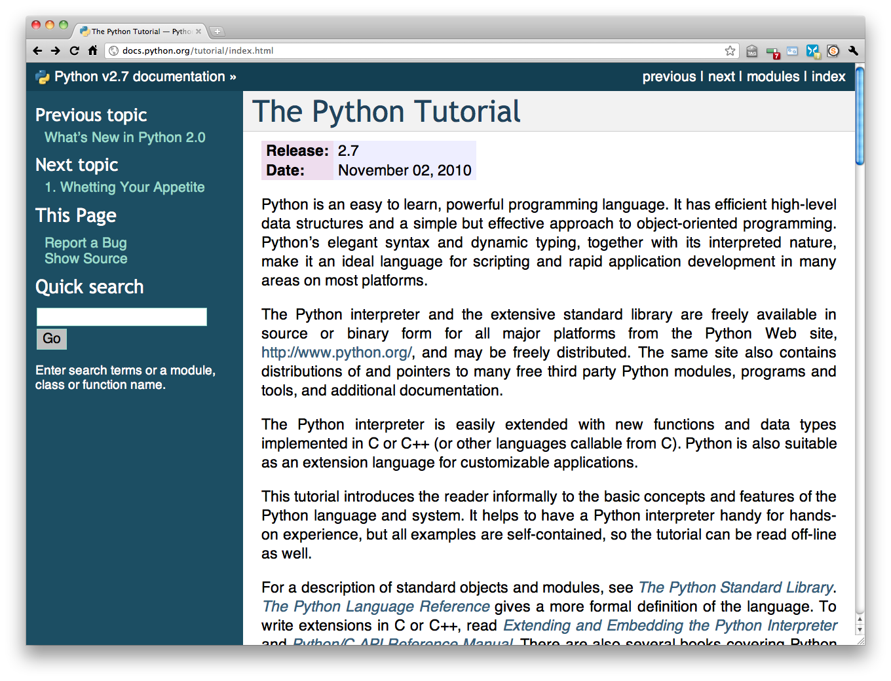
The Python tutorial is good!

Slide 8
Why Python? It’s Easy to Use
High-level language: Distinct from the low-level processor operations; closer to human language than machine language
"Programming at the speed of thought"
Increases productivity
  Python programs three to five times shorter than Java
  Python programs five to ten times shorter than C++
Normally, “Programming is like making fine furniture with an axe and a nail file.”
Python makes it more like working with a table saw & a lathe
  You still have to learn how to use them, but they’re the right tools for the job
Guide to Programming with Python

Slide 9
Python Is Easy to Use (continued)
Python Program
  print "Game Over!"
C++ Program
  #include <iostream>
  int main()
  {
  std::cout << "Game Over!" << std::endl;
  return 0;
  }
Guide to Programming with Python

Slide 10
Python Is Powerful
Used by large organizations
  NASA
  Google
  Microsoft
Used in published games
  Battlefield 2
  Civilization IV
  Disney’s Toontown Online
Used throughout academia and the scientific community
Guide to Programming with Python

Slide 11
Python Is Object-Oriented
Object-oriented programming (OOP): Methodology that defines problems in terms of objects that send messages to each other
  In a game, a Missile object could send a Ship object a message to Explode
OOP not required, unlike Java and C#
Guide to Programming with Python

Slide 12
Python Is a “Glue” Language
Can be integrated with other languages
  C/C++
  Java
Use existing code
Leverage strengths of other languages
  Extra speed that C or C++ offers
Guide to Programming with Python

Slide 13
Python Runs Everywhere
Platform independent: Independent of the specific computer operating system
Python runs on
  Windows
  DOS
  Mac OS X
  Linux
  Many more
Guide to Programming with Python

Slide 14
Python Is Free and Open Source
Open source: Publicly available; open source software typically programmed by volunteers; anyone can use source code without fee
Can modify or even resell Python
Embracing open-source ideals is part of what makes Python successful
Guide to Programming with Python

Slide 15
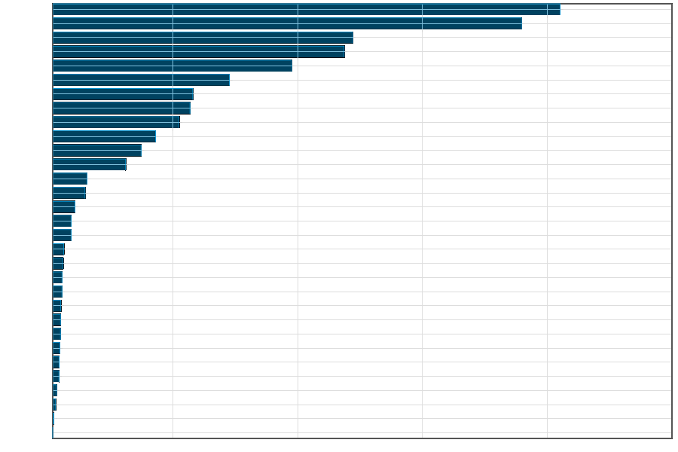
Python is Popular
All those advantages make Python a commonly used (and liked) language (http://www.langpop.com/):
Java
C
C++
Javascript
PHP
Python………
SQL
Perl
C#

Slide 16
Python Features
Easy-to-learn: Python has relatively few keywords, simple structure, and a clearly defined syntax. This allows the student to pick up the language in a relatively short period of time.
Easy-to-read: Python code is much more clearly defined and visible to the eyes.
Easy-to-maintain: Python's success is that its source code is fairly easy-to-maintain.
A broad standard library: One of Python's greatest strengths is the bulk of the library is very portable and cross-platform compatible on UNIX, Windows, and Macintosh.
Guide to Programming with Python

Slide 17
Python Features
Interactive Mode: Support for an interactive mode in which you can enter results from a terminal right to the language, allowing interactive testing and debugging of snippets of code.
Portable: Python can run on a wide variety of hardware platforms and has the same interface on all platforms.
Extendable: You can add low-level modules to the Python interpreter. These modules enable programmers to add to or customize their tools to be more efficient.
Guide to Programming with Python

Slide 18
Python Features
Databases: Python provides interfaces to all major commercial databases
GUI Programming: Python supports GUI applications that can be created and ported to many system calls, libraries, and windows systems, such as Windows MFC, Macintosh, and the X Window system of Unix.
Scalable: Python provides a better structure and support for large programs than shell scripting.
It can be easily integrated with C, C++, COM, ActiveX, CORBA, and Java
Guide to Programming with Python

Slide 19

Running Python

Slide 20
The Python Interpreter
Typical Python implementations offer
both an interpreter and compiler
Interactive interface to Python with a
read-eval-print loop
    [finin@linux2 ~]$ python
    Python 2.4.3 (#1, Jan 14 2008, 18:32:40)
    [GCC 4.1.2 20070626 (Red Hat 4.1.2-14)] on linux2
    Type "help", "copyright", "credits" or "license" for more information.
    >>> def square(x):
    ... return x * x
    ...
    >>> map(square, [1, 2, 3, 4])
    [1, 4, 9, 16]
    >>>

Slide 21
Installing
Python is pre-installed on most Unix systems, including Linux and MAC OS X
The pre-installed version may not be the most recent
Two “latest versions”
  2.7 released 7/10 & 3.2 released 10/10
  Python 3 is a non-backward compatible version which you should not use for 331
Download from http://python.org/download/
Python comes with a large library of standard modules

Slide 22
Python Environment Variables
Variable | Description
PYTHONPATH | Has a role similar to PATH. This variable tells the Python interpreter where to locate the module files you import into a program. PYTHONPATH should include the Python source library directory and the directories containing your Python source code. PYTHONPATH is sometimes preset by the Python installer.
PYTHONSTARTUP | Contains the path of an initialization file containing Python source code that is executed every time you start the interpreter (similar to the Unix .profile or .login file). This file, often named .pythonrc.py in Unix, usually contains commands that load utilities or modify PYTHONPATH.
PYTHONCASEOK | Used in Windows to instruct Python to find the first case-insensitive match in an import statement. Set this variable to any value to activate it.
PYTHONHOME | An alternative module search path. It's usually embedded in the PYTHONSTARTUP or PYTHONPATH directories to make switching module libraries easy.
Guide to Programming with Python

Slide 23
Python IDEs and Shells
There are many Integrated Development Environments
  IDLE
  Eclipse + PyDev
  Emacs
As well as enhanced shells

Slide 24
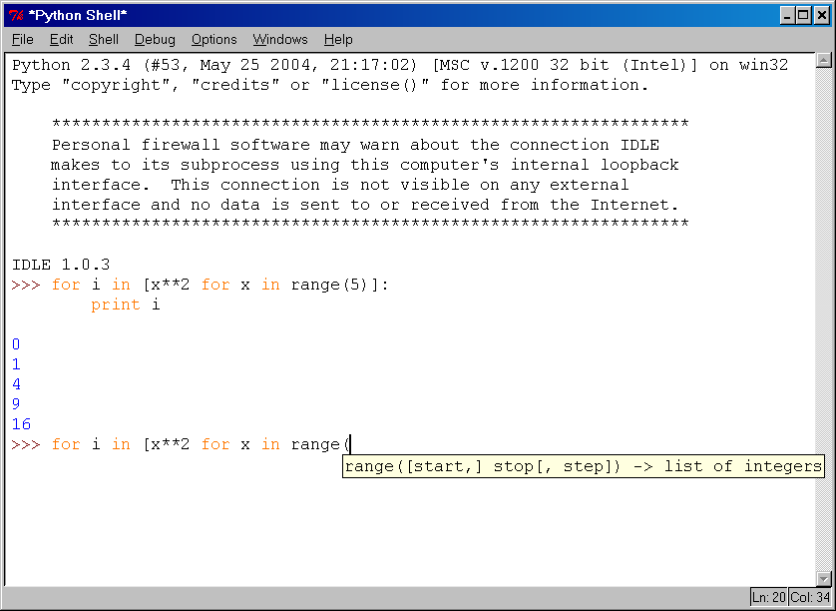
IDLE Development Environment
IDLE is the “official” IDE distributed with Python
Preinstalled on MAC OS X
Written in Python with the Tkinter GUI package
Multi-window text editor with syntax highlighting, auto-completion, smart indent and other features
Python shell with syntax highlighting, line recall, …
Integrated debugger
with stepping, persis-
tent breakpoints,
and call stack visi-
bility

Slide 25

Eclipse + Pydev
Pydev is an Eclipse plugin for
Python
Download from http://pydev.org/
Syntax highlighting, code completion, goto function, debugger, …

Slide 26
Emacs as a Python IDE
You can fire up a shell in emacs via M-x python-shell
You can also set up a more powerful Python IDE environment in EMACS
  Pymacs allows two-way communication between Emacs Lisp and Python
  Ropemacs provides advanced features such as completion, refactoring, etc

Slide 27
Running Interactively on UNIX
On Unix…
  % python
  >>> 3+3
  6
Python prompts with ‘>>>’.
To exit Python (not Idle):
  In Unix, type CONTROL-D
  In Windows, type CONTROL-Z + <Enter>
  Evaluate exit()

Slide 28
Running Programs on UNIX
Call python program via the python interpreter
  % python fact.py
Make a python file directly executable by
  Adding the appropriate path to your python interpreter as the first line of your file
    #!/usr/bin/python
  Making the file executable
    % chmod a+x fact.py
  Invoking file from Unix command line
    % fact.py

Slide 29
Python Memory Management
Memory management in Python involves a private heap containing all Python objects and data structures.
The management of this private heap is ensured internally by the Python memory manager.
The Python memory manager has different components which deal with various dynamic storage management aspects, like sharing, segmentation, pre allocation or caching.
Guide to Programming with Python

Slide 30
Python Memory Management
At the lowest level, a raw memory allocator ensures that there is enough room in the private heap for storing all Python-related data by interacting with the memory manager of the operating system.
Guide to Programming with Python

Slide 31
Python Memory Management
On top of the raw memory allocator, several object-specific allocators operate on the same heap and implement distinct memory management policies adapted to the peculiarities of every object type.
Guide to Programming with Python

Slide 32
Python Memory Management
For example, integer objects are managed differently within the heap than strings, tuples or dictionaries because integers imply different storage requirements and speed/space tradeoffs.
The Python memory manager thus delegates some of the work to the object-specific allocators, but ensures that the latter operate within the bounds of the private heap.
Guide to Programming with Python

Slide 33
Python Memory Management
Management of the Python heap is performed by the interpreter itself and that the user has no control over it.
The allocation of heap space for Python objects and other internal buffers is performed on demand by the Python memory manager through the Python/C API functions listed in this document.
Guide to Programming with Python

Slide 34
Python Identifiers
A Python identifier is a name used to identify a variable, function, class, module, or other object.
An identifier starts with a letter A to Z or a to z or an underscore (_) followed by zero or more letters, underscores, and digits (0 to 9).
Python does not allow punctuation characters such as @, $, and % within identifiers.
Python is a case sensitive programming language.
Guide to Programming with Python

Slide 35
Identifier naming convention for Python
Class names start with an uppercase letter and all other identifiers with a lowercase letter.
Starting an identifier with a single leading underscore indicates by convention that the identifier is meant to be private.
Starting an identifier with two leading underscores indicates a strongly private identifier.
If the identifier also ends with two trailing underscores, the identifier is a language-defined special name.
Guide to Programming with Python

Slide 36
Reserved Words
and | exec | not
assert | finally | or
break | for | pass
class | from | print
continue | global | raise
def | if | return
del | import | try
elif | in | while
else | is | with
except | lambda | yield
Guide to Programming with Python

Slide 37
Lines and Indentation
One of the first caveats programmers encounter when learning Python is the fact that there are no braces to indicate blocks of code for class and function definitions or flow control.
Blocks of code are denoted by line indentation, which is rigidly enforced.
The number of spaces in the indentation is variable, but all statements within the block must be indented the same amount.
Guide to Programming with Python

Slide 38
Indentation Error
if True:
print "Answer“
print "True"
else:
print "Answer"
print "False"
Guide to Programming with Python

Slide 39
Multi-Line Statements
Statements in Python typically end with a new line.
Python does, however, allow the use of the line continuation character (\) to denote that the line should continue.
total = item_one + \
item_two + \
item_three
Guide to Programming with Python

Slide 40
Quotation in Python
Python accepts single ('), double (") and triple (''' or """) quotes to denote string literals, as long as the same type of quote starts and ends the string.
word = 'word' sentence = "This is a sentence." paragraph = """This is a paragraph. It is made up of multiple lines and sentences."""
Guide to Programming with Python

Slide 41
Comments in Python
A hash sign (#) that is not inside a string literal begins a comment.
All characters after the # and up to the physical line end are part of the comment, and the Python interpreter ignores them.
#!/usr/bin/python
# First comment
print "Hello, Python!“; # second comment
Guide to Programming with Python

Slide 42
Using Blank Lines
A line containing only whitespace, possibly with a comment, is known as a blank line, and Python totally ignores it.
In an interactive interpreter session, you must enter an empty physical line to terminate a multiline statement.
Guide to Programming with Python

Slide 43
Waiting for the User
The following line of the program displays the prompt, Press the enter key to exit. and waits for the user to press the Enter key.
#!/usr/bin/python
raw_input("\n\nPress the enter key to exit.")
Guide to Programming with Python

Slide 44
Multiple Statements on a Single Line
The semicolon ( ; ) allows multiple statements on the single line given that neither statement starts a new code block.
Here is a sample snip using the semicolon
import sys; x = 'foo';
sys.stdout.write(x + '\n')
Guide to Programming with Python

Slide 45
Multiple Statement Groups as Suites
A groups of individual statements which makes a single code block are called suites in Python.
Compound or complex statements, such as if, while, def, and class, are those which require a header line and a suite.
Header lines begin the statement (with the keyword) and terminate with a colon ( : ) and are followed by one or more lines which make up the suite.
Guide to Programming with Python

Slide 46
Multiple Statement Groups as Suites
if expression :
suite
elif expression :
suite
else :
suite
Guide to Programming with Python

Slide 47
Command Line Arguments
python -h
usage: python [option] ... [-c cmd | -m mod | file | -] [arg] ... Options and arguments (and corresponding environment variables):
-c cmd : program passed in as string (terminates option list)
-d : debug output from parser (also PYTHONDEBUG=x)
-E : ignore environment variables (such as PYTHONPATH)
-h : print this help message and exit [ etc. ]
Guide to Programming with Python

Slide 48
Assigning Values to Variables
Python variables do not have to be explicitly declared to reserve memory space.
The declaration happens automatically when you assign a value to a variable.
The equal sign (=) is used to assign values to variables.
The operand to the left of the = operator is the name of the variable, and the operand to the right of the = operator is the value stored in the variable.
Guide to Programming with Python

Slide 49
Assigning Values to Variables
#!/usr/bin/python
counter = 100 # An integer assignment
miles = 1000.0 # A floating point
name = "John" # A string
print counter
print miles
print name
Guide to Programming with Python

Slide 50
Multiple Assignment
Python allows you to assign a single value to several variables simultaneously
a = b = c = 1
Guide to Programming with Python

Slide 51
Standard Data Types
Python has five standard data types:
  Numbers
  String
  List
  Tuple
  Dictionary
Guide to Programming with Python

Slide 52
Python Numbers
Number data types store numeric values.
They are immutable data types, which means that changing the value of a number data type results in a newly allocated object.
Number objects are created when you assign a value to them.
var1 = 1
var2 = 10
# You can delete a single object or multiple objects by using the del statement
del var
del var_a, var_b
Guide to Programming with Python

Slide 53
Python supports four different numerical types
int (signed integers)
long (long integers [can also be represented in octal and hexadecimal])
float (floating point real values)
complex (complex numbers)
Guide to Programming with Python

Slide 54
Python supports four different numerical types
int | long | float | complex
10 | 51924361L | 0.0 | 3.14j
100 | -0x19323L | 15.20 | 45.j
-786 | 0122L | -21.9 | 9.322e-36j
080 | 0xDEFABCECBDAECBFBAEl | 32.3+e18 | .876j
-0490 | 535633629843L | -90. | -.6545+0J
-0x260 | -052318172735L | -32.54e100 | 3e+26J
0x69 | -4721885298529L | 70.2-E12 | 4.53e-7j
Guide to Programming with Python

Slide 55
Data Type Conversion
Function | Description
int(x [,base]) | Converts x to an integer. base specifies the base if x is a string.
long(x [,base] ) | Converts x to a long integer. base specifies the base if x is a string.
float(x) | Converts x to a floating-point number.
complex(real [,imag]) | Creates a complex number.
str(x) | Converts object x to a string representation.
repr(x) | Converts object x to an expression string.
Guide to Programming with Python

Slide 56
Data Type Conversion
eval(str) | Evaluates a string and returns an object.
tuple(s) | Converts s to a tuple.
list(s) | Converts s to a list.
set(s) | Converts s to a set.
dict(d) | Creates a dictionary. d must be a sequence of (key,value) tuples.
frozenset(s) | Converts s to a frozen set.
chr(x) | Converts an integer to a character.
unichr(x) | Converts an integer to a Unicode character.
Guide to Programming with Python

Slide 57
Data Type Conversion
ord(x) | Converts a single character to its integer value.
hex(x) | Converts an integer to a hexadecimal string.
oct(x) | Converts an integer to an octal string.
Guide to Programming with Python

Slide 58
Python Basic Operators
Operator | Description | Example
+ | Addition - Adds values on either side of the operator | a + b will give 30
- | Subtraction - Subtracts right hand operand from left hand operand | a - b will give -10
* | Multiplication - Multiplies values on either side of the operator | a * b will give 200
/ | Division - Divides left hand operand by right hand operand | b / a will give 2
% | Modulus - Divides left hand operand by right hand operand and returns remainder | b % a will give 0
** | Exponent - Performs exponential (power) calculation on operators | a**b will give 10 to the power 20
// | Floor Division - The division of operands where the result is the quotient in which the digits after the decimal point are removed. | 9//2 is equal to 4 and 9.0//2.0 is equal to 4.
Guide to Programming with Python

Slide 59
Python Comparison Operators
Operator | Description | Example
== | Checks if the value of two operands are equal or not, if yes then condition becomes true. | (a == b) is not true.
!= | Checks if the value of two operands are equal or not, if values are not equal then condition becomes true. | (a != b) is true.
<> | Checks if the value of two operands are equal or not, if values are not equal then condition becomes true. | (a <> b) is true. This is similar to != operator.
> | Checks if the value of left operand is greater than the value of right operand, if yes then condition becomes true. | (a > b) is not true.
< | Checks if the value of left operand is less than the value of right operand, if yes then condition becomes true. | (a < b) is true.
>= | Checks if the value of left operand is greater than or equal to the value of right operand, if yes then condition becomes true. | (a >= b) is not true.
<= | Checks if the value of left operand is less than or equal to the value of right operand, if yes then condition becomes true. | (a <= b) is true.
Guide to Programming with Python

Slide 60
Python Assignment Operators
Operator | Description | Example
= | Simple assignment operator, Assigns values from right side operands to left side operand | c = a + b will assigne value of a + b into c
+= | Add AND assignment operator, It adds right operand to the left operand and assign the result to left operand | c += a is equivalent to c = c + a
-= | Subtract AND assignment operator, It subtracts right operand from the left operand and assign the result to left operand | c -= a is equivalent to c = c - a
*= | Multiply AND assignment operator, It multiplies right operand with the left operand and assign the result to left operand | c *= a is equivalent to c = c * a
/= | Divide AND assignment operator, It divides left operand with the right operand and assign the result to left operand | c /= a is equivalent to c = c / a
Guide to Programming with Python

Slide 61
Python Assignment Operators
%= | Modulus AND assignment operator, It takes modulus using two operands and assign the result to left operand | c %= a is equivalent to c = c % a
**= | Exponent AND assignment operator, Performs exponential (power) calculation on operators and assign value to the left operand | c **= a is equivalent to c = c ** a
//= | Floor Dividion and assigns a value, Performs floor division on operators and assign value to the left operand | c //= a is equivalent to c = c // a
Guide to Programming with Python

Slide 62
Python Bitwise Operators
Operator | Description | Example
& | Binary AND Operator copies a bit to the result if it exists in both operands. | (a & b) will give 12 which is 0000 1100
| | Binary OR Operator copies a bit if it exists in eather operand. | (a | b) will give 61 which is 0011 1101
^ | Binary XOR Operator copies the bit if it is set in one operand but not both. | (a ^ b) will give 49 which is 0011 0001
~ | Binary Ones Complement Operator is unary and has the efect of 'flipping' bits. | (~a ) will give -60 which is 1100 0011
<< | Binary Left Shift Operator. The left operands value is moved left by the number of bits specified by the right operand. | a << 2 will give 240 which is 1111 0000
>> | Binary Right Shift Operator. The left operands value is moved right by the number of bits specified by the right operand. | a >> 2 will give 15 which is 0000 1111
Guide to Programming with Python

Slide 63
Python Logical Operators
Operator | Description | Example
and | Called Logical AND operator. If both the operands are true then then condition becomes true. | (a and b) is true.
or | Called Logical OR Operator. If any of the two operands are non zero then then condition becomes true. | (a or b) is true.
not | Called Logical NOT Operator. Use to reverses the logical state of its operand. If a condition is true then Logical NOT operator will make false. | not(a and b) is false.
Guide to Programming with Python

Slide 64
Python Membership Operators
Operator | Description | Example
in | Evaluates to true if it finds a variable in the specified sequence and false otherwise. | x in y, here in results in a 1 if x is a member of sequence y.
not in | Evaluates to true if it does not finds a variable in the specified sequence and false otherwise. | x not in y, here not in results in a 1 if x is a member of sequence y.
Guide to Programming with Python

Slide 65
Python Identity Operators
Operator | Description | Example
is | Evaluates to true if the variables on either side of the operator point to the same object and false otherwise. | x is y, here is results in 1 if id(x) equals id(y).
is not | Evaluates to false if the variables on either side of the operator point to the same object and true otherwise. | x is not y, here is not results in 1 if id(x) is not equal to id(y).
Guide to Programming with Python

Slide 66
Python Operators Precedence
Operator | Description
** | Exponentiation (raise to the power)
~ + - | Ccomplement, unary plus and minus (method names for the last two are +@ and -@)
* / % // | Multiply, divide, modulo and floor division
+ - | Addition and subtraction
>> << | Right and left bitwise shift
& | Bitwise 'AND'
Guide to Programming with Python

Slide 67
Python Operators Precedence
^ | | Bitwise exclusive `OR' and regular `OR'
<= < > >= | Comparison operators
<> == != | Equality operators
= %= /= //= -= += *= **= | Assignment operators
is is not | Identity operators
in not in | Membership operators
not or and | Logical operators
Guide to Programming with Python

Slide 68
Python Decision Making
Statement | Description
if statements | An if statement consists of a boolean expression followed by one or more statements.
if...else statements | An if statement can be followed by an optional else statement, which executes when the boolean expression is false.
nested if statements | You can use one if or else if statement inside another if or else if statement(s).
Guide to Programming with Python

Slide 69
Single Statement Suites
#!/usr/bin/python
var = 100
if ( var == 100 ) : print "Value of expression is 100“
print "Good bye!"
Guide to Programming with Python

Slide 70
Python IF...ELIF...ELSE Statements
#!/usr/bin/python
var = 100
if var == 200:
print "1 - Got a true expression value"
print var
elif var == 150:
print "2 - Got a true expression value"
print var2
Guide to Programming with Python

Slide 71
Python IF...ELIF...ELSE Statements
elif var == 100:
print "3 - Got a true expression value"
print var
else:
print "4 - Got a false expression value"
print var
print "Good bye!"
Guide to Programming with Python

Slide 72
Python while Loop Statements
#!/usr/bin/python
count = 0
while (count < 9):
print 'The count is:', count
count = count + 1
print "Good bye!"
Guide to Programming with Python

Slide 73
Python for Loop Statements
#!/usr/bin/python
for letter in 'Python': # First Example
print 'Current Letter :', letter
fruits = ['banana', 'apple', 'mango']
for fruit in fruits: # Second Example
print 'Current fruit :', fruit
print "Good bye!"
Guide to Programming with Python

Slide 74
Python nested loops
#!/usr/bin/python
i = 2
while(i < 100):
j = 2
while(j <= (i/j)):
if not(i%j): break
j = j + 1
if (j > i/j) : print i, " is prime"
i = i + 1
print "Good bye!"
Guide to Programming with Python

Slide 75
Python break statement
#!/usr/bin/python
for letter in 'Python': # First Example
if letter == 'h':
break
print 'Current Letter :', letter
var = 10 # Second Example
while var > 0:
print 'Current variable value :',
var var = var -1
if var == 5:
break
print "Good bye!"
Guide to Programming with Python

Slide 76
Python pass statement
The pass statement in Python is used when a statement is required syntactically but you do not want any command or code to execute.
The pass statement is a null operation; nothing happens when it executes.
The pass is also useful in places where your code will eventually go, but has not been written yet (e.g., in stubs for example):
Guide to Programming with Python

Slide 77
Python pass statement
for letter in 'Python':
if letter == 'h':
pass
print 'This is pass block'
print 'Current Letter :', letter
print "Good bye!"
Guide to Programming with Python

Slide 78
Mathematical Functions
Function | Returns ( description )
abs(x) | The absolute value of x: the (positive) distance between x and zero.
ceil(x) | The ceiling of x: the smallest integer not less than x
cmp(x, y) | -1 if x < y, 0 if x == y, or 1 if x > y
exp(x) | The exponential of x: e^{x}
fabs(x) | The absolute value of x.
floor(x) | The floor of x: the largest integer not greater than x
Guide to Programming with Python

Slide 79
Mathematical Functions
log(x) | The natural logarithm of x, for x> 0
log10(x) | The base-10 logarithm of x for x> 0 .
max(x1, x2,...) | The largest of its arguments: the value closest to positive infinity
min(x1, x2,...) | The smallest of its arguments: the value closest to negative infinity
modf(x) | The fractional and integer parts of x in a two-item tuple. Both parts have the same sign as x. The integer part is returned as a float.
pow(x, y) | The value of x**y.
round(x [,n]) | x rounded to n digits from the decimal point. Python rounds away from zero as a tie-breaker: round(0.5) is 1.0 and round(-0.5) is -1.0.
sqrt(x) | The square root of x for x > 0
Guide to Programming with Python

Slide 80
Random Number Functions
Function | Description
choice(seq) | A random item from a list, tuple, or string.
randrange ([start,] stop [,step]) | A randomly selected element from range(start, stop, step)
random() | A random float r, such that 0 is less than or equal to r and r is less than 1
seed([x]) | Sets the integer starting value used in generating random numbers. Call this function before calling any other random module function. Returns None.
shuffle(lst) | Randomizes the items of a list in place. Returns None.
uniform(x, y) | A random float r, such that x is less than or equal to r and r is less than y
Guide to Programming with Python

Slide 81
Trigonometric Functions
Function | Description
acos(x) | Return the arc cosine of x, in radians.
asin(x) | Return the arc sine of x, in radians.
atan(x) | Return the arc tangent of x, in radians.
atan2(y, x) | Return atan(y / x), in radians.
cos(x) | Return the cosine of x radians.
hypot(x, y) | Return the Euclidean norm, sqrt(x*x + y*y).
sin(x) | Return the sine of x radians.
tan(x) | Return the tangent of x radians.
degrees(x) | Converts angle x from radians to degrees.
radians(x) | Converts angle x from degrees to radians.
Guide to Programming with Python

Slide 82
Mathematical Constants
Constants | Description
pi | The mathematical constant pi.
e | The mathematical constant e.
Guide to Programming with Python

Slide 83
Python Strings
Strings in Python are identified as a contiguous set of characters in between quotation marks.
Python allows for either pairs of single or double quotes.
Subsets of strings can be taken using the slice operator ( [ ] and [ : ] ) with indexes starting at 0 in the beginning of the string and working their way from -1 at the end.
Guide to Programming with Python

Slide 84
Python Strings
#!/usr/bin/python
str = 'Hello World!'
print str # Prints complete string
print str[0] # Prints first character of the string
print str[2:5] # Prints characters starting from 3rd to 5th
print str[2:] # Prints string starting from 3rd character print str * 2 # Prints string two times
print str + "TEST" # Prints concatenated string
Guide to Programming with Python

Slide 85
Python Strings
Accessing Values in Strings
#!/usr/bin/python
var1 = 'Hello World!'
var2 = "Python Programming"
print "var1[0]: ", var1[0]
print "var2[1:5]: ", var2[1:5]
Guide to Programming with Python

Slide 86
Updating Strings
#!/usr/bin/python
var1 = 'Hello World!'
print "Updated String :- ", var1[:6] + 'Python'
Guide to Programming with Python

Slide 87
Escape Characters
Backslash notation | Hexadecimal character | Description
\a | 0x07 | Bell or alert
\b | 0x08 | Backspace
\cx |  | Control-x
\C-x |  | Control-x
\e | 0x1b | Escape
\f | 0x0c | Formfeed
\M-\C-x |  | Meta-Control-x
\n | 0x0a | Newline
Guide to Programming with Python

Slide 88
Escape Characters
\nnn |  | Octal notation, where n is in the range 0.7
\r | 0x0d | Carriage return
\s | 0x20 | Space
\t | 0x09 | Tab
\v | 0x0b | Vertical tab
\x |  | Character x
\xnn |  | Hexadecimal notation, where n is in the range 0.9, a.f, or A.F
Guide to Programming with Python

Slide 89
String Special Operators
Operator | Description | Example
+ | Concatenation - Adds values on either side of the operator | a + b will give HelloPython
* | Repetition - Creates new strings, concatenating multiple copies of the same string | a*2 will give -HelloHello
[] | Slice - Gives the character from the given index | a[1] will give e
[ : ] | Range Slice - Gives the characters from the given range | a[1:4] will give ell
in | Membership - Returns true if a character exists in the given string | H in a will give 1
Guide to Programming with Python

Slide 90
String Special Operators
not in | Membership - Returns true if a character does not exist in the given string | M not in a will give 1
r/R | Raw String - Suppress actual meaning of Escape characters. The syntax for raw strings is exactly the same as for normal strings with the exception of the raw string operator, the letter "r," which precedes the quotation marks. The "r" can be lowercase (r) or uppercase (R) and must be placed immediately preceding the first quote mark. | print r'\n' prints \n and print R'\n' prints \n
Guide to Programming with Python

Slide 91
String Formatting Operator
#!/usr/bin/python
print "My name is %s and weight is %d kg!" % ('Zara', 21)
Guide to Programming with Python

Slide 92
String Formatting Operator
Format Symbol | Conversion
%c | character
%s | string conversion via str() prior to formatting
%i | signed decimal integer
%d | signed decimal integer
%u | unsigned decimal integer
%o | octal integer
%x | hexadecimal integer (lowercase letters)
Guide to Programming with Python

Slide 93
String Formatting Operator
%X | hexadecimal integer (UPPERcase letters)
%e | exponential notation (with lowercase 'e')
%E | exponential notation (with UPPERcase 'E')
%f | floating point real number
%g | the shorter of %f and %e
%G | the shorter of %f and %E
Guide to Programming with Python

Slide 94
Triple Quotes
Python's triple quotes comes to the rescue by allowing strings to span multiple lines, including verbatim NEWLINEs, TABs, and any other special characters.
Guide to Programming with Python

Slide 95
Triple Quotes
#!/usr/bin/python
para_str = """this is a long string that is made up of
several lines and non-printable characters such as
TAB ( \t ) and they will show up that way when displayed.
NEWLINEs within the string, whether explicitly given like
this within the brackets [ \n ], or just a NEWLINE within
the variable assignment will also show up.
"""
print para_str;
Guide to Programming with Python

Slide 96
Raw String
#!/usr/bin/python
print 'C:\\nowhere‘
C:\nowhere #output
#!/usr/bin/python
print r'C:\\nowhere‘
C:\\nowhere #output
Guide to Programming with Python

Slide 97
Unicode String
#!/usr/bin/python
print u'Hello, world!'
Guide to Programming with Python

Slide 98
Python String capitalize() Method
This method returns a copy of the string with only its first character capitalized. For 8-bit strings, this method is locale-dependent.
#!/usr/bin/python
str = "this is string example....wow!!!";
print "str.capitalize() : ", str.capitalize()
Guide to Programming with Python

Slide 99
Python String center() Method
This method returns centered in a string of length width.
Padding is done using the specified fillchar.
Default filler is a space.
#!/usr/bin/python
str = "this is string example....wow!!!";
print "str.center(40, 'a') : ", str.center(40, 'a')
Guide to Programming with Python

Slide 100
Built-in String Methods
SN | Methods with Description
1 | capitalize() Capitalizes first letter of string
2 | center(width, fillchar) Returns a space-padded string with the original string centered to a total of width columns
3 | count(str, beg= 0,end=len(string)) Counts how many times str occurs in string, or in a substring of string if starting index beg and ending index end are given
3 | decode(encoding='UTF-8',errors='strict') Decodes the string using the codec registered for encoding. encoding defaults to the default string encoding.
4 | encode(encoding='UTF-8',errors='strict') Returns encoded string version of string; on error, default is to raise a ValueError unless errors is given with 'ignore' or 'replace'.
5 | endswith(suffix, beg=0, end=len(string)) Determines if string or a substring of string (if starting index beg and ending index end are given) ends with suffix; Returns true if so, and false otherwise
Guide to Programming with Python

Slide 101
Built-in String Methods
6 | expandtabs(tabsize=8) Expands tabs in string to multiple spaces; defaults to 8 spaces per tab if tabsize not provided
7 | find(str, beg=0 end=len(string)) Determine if str occurs in string, or in a substring of string if starting index beg and ending index end are given; returns index if found and -1 otherwise
8 | index(str, beg=0, end=len(string)) Same as find(), but raises an exception if str not found
9 | isa1num() Returns true if string has at least 1 character and all characters are alphanumeric and false otherwise
10 | isalpha() Returns true if string has at least 1 character and all characters are alphabetic and false otherwise
11 | isdigit() Returns true if string contains only digits and false otherwise
12 | islower() Returns true if string has at least 1 cased character and all cased characters are in lowercase and false otherwise
Guide to Programming with Python

Slide 102
Built-in String Methods
13 | isnumeric() Returns true if a unicode string contains only numeric characters and false otherwise
14 | isspace() Returns true if string contains only whitespace characters and false otherwise
15 | istitle() Returns true if string is properly "titlecased" and false otherwise
16 | isupper() Returns true if string has at least one cased character and all cased characters are in uppercase and false otherwise
17 | join(seq) Merges (concatenates) the string representations of elements in sequence seq into a string, with separator string
18 | len(string) Returns the length of the string
Guide to Programming with Python

Slide 103
Built-in String Methods
19 | ljust(width[, fillchar]) Returns a space-padded string with the original string left-justified to a total of width columns
20 | lower() Converts all uppercase letters in string to lowercase
21 | lstrip() Removes all leading whitespace in string
22 | maketrans() Returns a translation table to be used in translate function.
23 | max(str) Returns the max alphabetical character from the string str
24 | min(str) Returns the min alphabetical character from the string str
25 | replace(old, new [, max]) Replaces all occurrences of old in string with new, or at most max occurrences if max given
Guide to Programming with Python

Slide 104
Built-in String Methods
26 | rfind(str, beg=0,end=len(string)) Same as find(), but search backwards in string
27 | rindex( str, beg=0, end=len(string)) Same as index(), but search backwards in string
28 | rjust(width,[, fillchar]) Returns a space-padded string with the original string right-justified to a total of width columns.
29 | rstrip() Removes all trailing whitespace of string
30 | split(str="", num=string.count(str)) Splits string according to delimiter str (space if not provided) and returns list of substrings; split into at most num substrings if given
31 | splitlines( num=string.count('\n')) Splits string at all (or num) NEWLINEs and returns a list of each line with NEWLINEs removed
32 | startswith(str, beg=0,end=len(string)) Determines if string or a substring of string (if starting index beg and ending index end are given) starts with substring str; Returns true if so, and false otherwise
Guide to Programming with Python

Slide 105
Built-in String Methods
33 | strip([chars]) Performs both lstrip() and rstrip() on string
34 | swapcase() Inverts case for all letters in string
35 | title() Returns "titlecased" version of string, that is, all words begin with uppercase, and the rest are lowercase
36 | translate(table, deletechars="") Translates string according to translation table str(256 chars), removing those in the del string
37 | upper() Converts lowercase letters in string to uppercase
38 | zfill (width) Returns original string leftpadded with zeros to a total of width characters; intended for numbers, zfill() retains any sign given (less one zero)
39 | isdecimal() Returns true if a unicode string contains only decimal characters and false otherwise
Guide to Programming with Python

Slide 106
Encoding Standards
Codec | Aliases | Operand type | Purpose
base64_codec | base64, base-64 | byte string | Convert operand to MIME base64
bz2_codec | bz2 | byte string | Compress the operand using bz2
hex_codec | hex | byte string | Convert operand to hexadecimal representation, with two digits per byte
idna |  | Unicode string | Implements RFC 3490, see alsoencodings.idna
mbcs | dbcs | Unicode string | Windows only: Encode operand according to the ANSI codepage (CP_ACP)
palmos |  | Unicode string | Encoding of PalmOS 3.5
punycode |  | Unicode string | Implements RFC 3492
quopri_codec | quopri, quoted-printable, quotedprintable | byte string | Convert operand to MIME quoted printable
Guide to Programming with Python

Slide 107
Python Lists
Lists are the most versatile of Python's compound data types.
A list contains items separated by commas and enclosed within square brackets ([]).
To some extent, lists are similar to arrays in C.
One difference between them is that all the items belonging to a list can be of different data type.
Guide to Programming with Python

Slide 108
Python Lists
The values stored in a list can be accessed using the slice operator ( [ ] and [ : ] ) with indexes starting at 0 in the beginning of the list and working their way to end-1.
The plus ( + ) sign is the list concatenation operator, and the asterisk ( * ) is the repetition operator.
Guide to Programming with Python

Slide 109
Python Lists
#!/usr/bin/python
list = [ 'abcd', 786 , 2.23, 'john', 70.2 ]
tinylist = [123, 'john']
print list # Prints complete list
print list[0] # Prints first element of the list
print list[1:3] # Prints elements starting from 2nd till 3rd
print list[2:] # Prints elements starting from 3rd element
print tinylist * 2 # Prints list two times
print list + tinylist # Prints concatenated lists
Guide to Programming with Python

Slide 110
Updating Lists:
#!/usr/bin/python
list = ['physics', 'chemistry', 1997, 2000];
print "Value available at index 2 : "
print list[2];
list[2] = 2001;
print "New value available at index 2 : "
print list[2];
Guide to Programming with Python

Slide 111
Delete List Elements
#!/usr/bin/python
list1 = ['physics', 'chemistry', 1997, 2000];
print list1;
del list1[2];
print "After deleting value at index 2 : "
print list1;
Guide to Programming with Python

Slide 112
Basic List Operations
Python Expression | Results | Description
len([1, 2, 3]) | 3 | Length
[1, 2, 3] + [4, 5, 6] | [1, 2, 3, 4, 5, 6] | Concatenation
['Hi!'] * 4 | ['Hi!', 'Hi!', 'Hi!', 'Hi!'] | Repetition
3 in [1, 2, 3] | True | Membership
for x in [1, 2, 3]: print x, | 1 2 3 | Iteration
Guide to Programming with Python

Slide 113
Indexing, Slicing, and Matrixes:
L = ['spam', 'Spam', 'SPAM!']
L =L = ['spam', 'Spam', 'SPAM!‘]
Python Expression | Results | Description
L[2] | 'SPAM!' | Offsets start at zero
L[-2] | 'Spam' | Negative: count from the right
L[1:] | ['Spam', 'SPAM!'] | Slicing fetches sections
Guide to Programming with Python

Slide 114
Built-in List Functions & Methods
SN | Function with Description
1 | cmp(list1, list2) Compares elements of both lists.
2 | len(list) Gives the total length of the list.
3 | max(list) Returns item from the list with max value.
4 | min(list) Returns item from the list with min value.
5 | list(seq) Converts a tuple into list.
Guide to Programming with Python

Slide 115
Built-in List Functions & Methods
SN | Methods with Description
1 | list.append(obj) Appends object obj to list
2 | list.count(obj) Returns count of how many times obj occurs in list
3 | list.extend(seq) Appends the contents of seq to list
4 | list.index(obj) Returns the lowest index in list that obj appears
5 | list.insert(index, obj) Inserts object obj into list at offset index
6 | list.pop(obj=list[-1]) Removes and returns last object or obj from list
7 | list.remove(obj) Removes object obj from list
8 | list.reverse() Reverses objects of list in place
9 | list.sort([func]) Sorts objects of list, use compare func if given
Guide to Programming with Python

Slide 116
Python Tuples
A tuple is another sequence data type that is similar to the list.
A tuple consists of a number of values separated by commas. Unlike lists, however, tuples are enclosed within parentheses.
The main differences between lists and tuples are: Lists are enclosed in brackets ( [ ] ), and their elements and size can be changed, while tuples are enclosed in parentheses ( ( ) ) and cannot be updated.
Guide to Programming with Python

Slide 117
Python Tuples
#!/usr/bin/python
tuple = ( 'abcd', 786 , 2.23, 'john', 70.2 )
tinytuple = (123, 'john')
print tuple # Prints complete list
print tuple[0] # Prints first element of the list
print tuple[1:3] # Prints elements starting from 2nd till 3rd
print tuple[2:] # Prints elements starting from 3rd element
print tinytuple * 2 # Prints list two times
print tuple + tinytuple # Prints concatenated lists
Guide to Programming with Python

Slide 118
Python Dictionary
Python's dictionaries are kind of hash table type.
They work like associative arrays or hashes found in Perl and consist of key-value pairs.
A dictionary keys can be almost any Python type, but are usually numbers or strings.
Values, on the other hand, can be any arbitrary Python object.
Dictionaries are enclosed by curly braces ( { } ) and values can be assigned and accessed using square braces ( [] ).
Dictionaries have no concept of order among elements. It is incorrect to say that the elements are "out of order"; they are simply unordered.
Guide to Programming with Python

Slide 119
Python Dictionary
#!/usr/bin/python
dict = {}
dict['one'] = "This is one“
dict[2] = "This is two“
tinydict = {'name': 'john','code':6734, 'dept': 'sales'}
print dict['one'] # Prints value for 'one' key
print dict[2] # Prints value for 2 key
print tinydict # Prints complete dictionary
print tinydict.keys() # Prints all the keys
print tinydict.values() # Prints all the values
Guide to Programming with Python

Slide 120
Built-in Dictionary functions
SN | Function with Description
1 | cmp(dict1, dict2) Compares elements of both dict.
2 | len(dict) Gives the total length of the dictionary. This would be equal to the number of items in the dictionary.
3 | str(dict) Produces a printable string representation of a dictionary
4 | type(variable) Returns the type of the passed variable. If passed variable is dictionary then it would return a dictionary type.
Guide to Programming with Python

Slide 121
SN | Methods with Description
1 | dict.clear() Removes all elements of dictionary dict
2 | dict.copy() Returns a shallow copy of dictionary dict
2 | dict.fromkeys() Create a new dictionary with keys from seq and values set to value.
3 | dict.get(key, default=None) For key key, returns value or default if key not in dictionary
4 | dict.has_key(key) Returns true if key in dictionary dict, false otherwise
Guide to Programming with Python

Slide 122
Built-in functions
5 | dict.items() Returns a list of dict's (key, value) tuple pairs
6 | dict.keys() Returns list of dictionary dict's keys
7 | dict.setdefault(key, default=None) Similar to get(), but will set dict[key]=default if key is not already in dict
8 | dict.update(dict2) Adds dictionary dict2's key-values pairs to dict
9 | dict.values() Returns list of dictionary dict2's values
Guide to Programming with Python

Slide 123
Functions
Function blocks begin with the keyword def followed by the function name and parentheses ( ( ) ).
Any input parameters or arguments should be placed within these parentheses. You can also define parameters inside these parentheses.
The code block within every function starts with a colon (:) and is indented.
The statement return [expression] exits a function, optionally passing back an expression to the caller. A return statement with no arguments is the same as return None.
Guide to Programming with Python

Slide 124
Module
The __init__.py files are required to make Python treat the directories as containing packages;
this is done to prevent directories with a common name, such as string, from unintentionally hiding valid modules that occur later (deeper) on the module search path.
In the simplest case, __init__.py can just be an empty file, but it can also execute initialization code for the package.

Slide 125
Regular Expression
re.match(pattern, string, flags=0)
Parameter | Description
pattern | This is the regular expression to be matched.
string | This is the string which would be searched to match the pattern
flags | You can specifiy different flags using bitwise OR (|). These are modifiers which are listed in the table below.
Guide to Programming with Python

Slide 126
Regular Expression
Match Object Methods | Description
group(num=0) | This methods returns entire match (or specific subgroup num)
groups() | This method return all matching subgroups in a tuple (empty if there weren't any)
Guide to Programming with Python

Slide 127
Regular-expression Modifiers - Option Flags
Modifier | Description
re.I | Performs case-insensitive matching.
re.L | Interprets words according to the current locale.This interpretation affects the alphabetic group (\w and \W), as well as word boundary behavior (\b and \B).
re.M | Makes $ match the end of a line (not just the end of the string) and makes ^ match the start of any line (not just the start of the string).
re.S | Makes a period (dot) match any character, including a newline.
re.U | Interprets letters according to the Unicode character set. This flag affects the behavior of \w, \W, \b, \B.
re.X | Permits "cuter" regular expression syntax. It ignores whitespace (except inside a set [] or when escaped by a backslash), and treats unescaped # as a comment marker.
Guide to Programming with Python

Slide 128
Regular-expression Modifiers - Option Flags
Modifier | Description
re.I | Performs case-insensitive matching.
re.L | Interprets words according to the current locale.This interpretation affects the alphabetic group (\w and \W), as well as word boundary behavior (\b and \B).
re.M | Makes $ match the end of a line (not just the end of the string) and makes ^ match the start of any line (not just the start of the string).
re.S | Makes a period (dot) match any character, including a newline.
re.U | Interprets letters according to the Unicode character set. This flag affects the behavior of \w, \W, \b, \B.
re.X | Permits "cuter" regular expression syntax. It ignores whitespace (except inside a set [] or when escaped by a backslash), and treats unescaped # as a comment marker.
Guide to Programming with Python

Slide 129
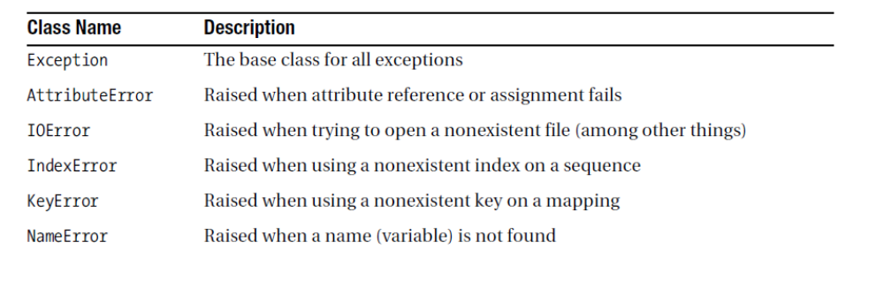
Exceptions
Guide to Programming with Python

Slide 130
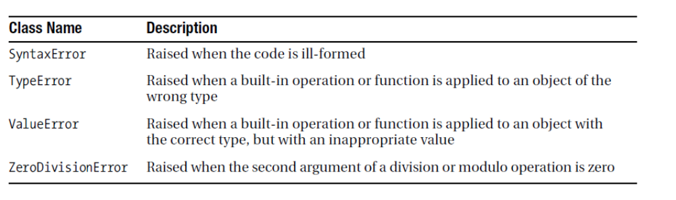
Exceptions
Guide to Programming with Python

Slide 131
%a Locale’s abbreviated weekday name.
%A Locale’s full weekday name.
%b Locale’s abbreviated month name.
%B Locale’s full month name.
%c Locale’s appropriate date and time representation.
%d Day of the month as a decimal number [01,31].
%f Microsecond as a decimal number [0,999999], zero-padded on the left
%H Hour (24-hour clock) as a decimal number [00,23].
%I Hour (12-hour clock) as a decimal number [01,12].
%j Day of the year as a decimal number [001,366].
%m Month as a decimal number [01,12].
%M Minute as a decimal number [00,59].
%p Locale’s equivalent of either AM or PM.
%S Second as a decimal number [00,61].
%U Week number of the year (Sunday as the first day of the week)
%w Weekday as a decimal number [0(Sunday),6].
%W Week number of the year (Monday as the first day of the week)
%x Locale’s appropriate date representation.
%X Locale’s appropriate time representation.
%y Year without century as a decimal number [00,99].
%Y Year with century as a decimal number.
%z UTC offset in the form +HHMM or -HHMM.
%Z Time zone name (empty string if the object is naive).
%% A literal '%' character.
Guide to Programming with Python

Slide 132
Python Debugging
Python –m pdb filename
Guide to Programming with Python

Slide 133
Command | Short form | What it does
args | a | Print the argument list of the current function
break | b | Creates a breakpoint (requires parameters) in the program execution
continue | c or cont | Continues program execution
help | h | Provides list of commands or help for a specified command
jump | j | Set the next line to be executed
list | l | Print the source code around the current line
next | n | Continue execution until the next line in the current function is reached or returns
step | s | Execute the current line, stopping at first possible occasion
pp | pp | Pretty-prints the value of the expression
quit or exit | q | Aborts the program
return | r | Continue execution until the current function returns
Guide to Programming with Python

Slide 134
PyIInstaller
pyinstaller.exe --onefile --windowed --icon=app.ico app.py
Guide to Programming with Python

Slide 135
Creating the Application Structure
/MyApplication
|-- run.py
|-- config.py
|__ /app
|-- __init__.py
|-- /module_one
|-- __init__.py
|-- controllers.py
|-- models.py
|__ /templates
|-- module_one
|-- hello.html
|__ /static
|__ ..
|__ .

Slide 136
How to Create The Distribution File
python setup.py sdist
Guide to Programming with Python

Slide 137
How to Install The Application
python setup.py install
For development
python setup.py develop
Guide to Programming with Python

Slide 138
SNMP
https://pynet.twb-tech.com/blog/snmp/python-snmp-intro.html
Guide to Programming with Python

Slide 139
SNMP
snmpget -v 2c -c <community> <ip_addr> .1.3.6.1.2.1.1.1.0
Guide to Programming with Python

Slide 140
Django Framework
pip install Django
python -c "import django; print(django.get_version())“
python -m django --version
django-admin startproject myproject
cd myproject
python manage.py runserver
python manage.py startapp myapp

Slide 141
Django Framework
INSTALLED_APPS = (
'django.contrib.admin',
'django.contrib.auth',
'django.contrib.contenttypes',
'django.contrib.sessions',
'django.contrib.messages',
'django.contrib.staticfiles',
'myapp',
)

Slide 142
Django Framework
python manage.py migrate
python manage.py makemigrations polls
python manage.py sqlmigrate polls 0001
python manage.py migrate
python manage.py createsuperuser
python manage.py runserver
http://localhost:8000/admin/
http://localhost:8000/hello/12/

Slide 143
Python Web Server
Python –m http.server 8080
Guide to Programming with Python

Slide 144
Higher Order Functions

Slide 145

MAP,FILTER AND REDUCE
Guide to Programming with Python

Slide 146
Meta class
A metaclass is a class whose instances are classes. Like an "ordinary" class defines the behavior of the instances of the class, a metaclass defines the behavior of classes and their instances.
Metaclasses are not supported by every object oriented programming language. Those programming language, which support metaclasses, considerably vary in way the implement them. Python is supporting them
Guide to Programming with Python

Slide 147
Meta Class
There are numerous use cases for metaclasses. Just to name a few:
logging and profiling
interface checking
registering classes at creation time
automatically adding new methods
automatic property creation
proxies
automatic resource locking/synchronization.
Guide to Programming with Python

Slide 148
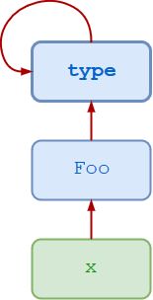
Meta Class
Guide to Programming with Python

Slide 149
Dynamic Meta class
>>> type(3)
<class 'int'>
>>> type(['foo', 'bar', 'baz'])
<class 'list'>
>>> t = (1, 2, 3, 4, 5)
>>> type(t)
<class 'tuple'>
Guide to Programming with Python

Slide 150
Dynamic Meta class
>>> class Foo:
... pass
...
>>> type(Foo())
<class '__main__.Foo'>
Guide to Programming with Python

Slide 151
Dynamic Meta class
You can also call type() with three arguments—type(<name>, <bases>, <dct>):
<name> specifies the class name. This becomes the __name__ attribute of the class.
<bases> specifies a tuple of the base classes from which the class inherits. This becomes the __bases__ attribute of the class.
<dct> specifies a namespace dictionary containing definitions for the class body. This becomes the __dict__ attribute of the class.
Guide to Programming with Python

Slide 152
Dynamic Meta class
>>> Bar = type('Bar', (Foo,), dict(attr=100))
>>> x = Bar()
>>> x.attr
100
>>> x.__class__
<class '__main__.Bar'>
>>> x.__class__.__bases__
(<class '__main__.Foo'>,)
Guide to Programming with Python

Slide 153
Decorators
A decorator in Python is any callable Python object that is used to modify a function or a class.
A reference to a function "func" or a class "C" is passed to a decorator and the decorator returns a modified function or class.
The modified functions or classes usually contain calls to the original function "func" or class "C".
Guide to Programming with Python

Slide 154
Pandas
Pandas is used for data manipulation, analysis and cleaning. Python pandas is well suited for different kinds of data, such as:
Tabular data with heterogeneously-typed columns
Ordered and unordered time series data
Arbitrary matrix data with row & column labels
Unlabelled data
Any other form of observational or statistical data sets
Guide to Programming with Python

Slide 155
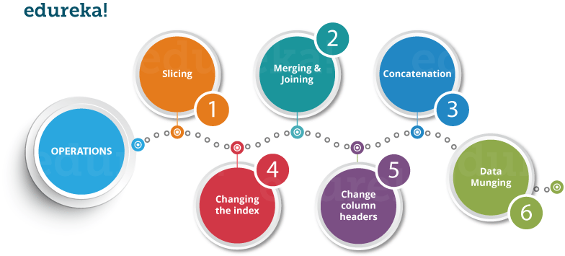
Pandas
Guide to Programming with Python

Slide 156
Lambdas
In Python, anonymous function is a function that is defined without a name.
While normal functions are defined using the def keyword, in Python anonymous functions are defined using the lambda keyword.
Guide to Programming with Python

Slide 157
How to use lambda Functions in Python?
A lambda function in python has the following syntax.
Syntax of Lambda Function in python
lambda arguments: expression
Lambda functions can have any number of arguments but only one expression.
The expression is evaluated and returned. Lambda functions can be used wherever function objects are required.
Guide to Programming with Python

Slide 158
How to use lambda Functions in Python?
Lambda functions can have any number of arguments but only one expression.
The expression is evaluated and returned.
Lambda functions can be used wherever function objects are required.
Guide to Programming with Python

Slide 159
Regular Expression
A regular expression is a special sequence of characters that helps you match or find other strings or sets of strings, using a specialized syntax held in a pattern.
Regular expressions are widely used in UNIX world.
The module re provides full support for Perl-like regular expressions in Python.
The re module raises the exception re.error if an error occurs while compiling or using a regular expression
Guide to Programming with Python

Slide 160
Regular Expression
In regular expressions, there are twelve metacharacters that should be escaped if they are to be used with their literal meaning:
Backslash \
• Caret ^
• Dollar sign $
• Dot .
Guide to Programming with Python

Slide 161
Regular Expression
Pipe symbol |
• Question mark ?
• Asterisk *
• Plus sign +
• Opening parenthesis (
• Closing parenthesis )
• Opening square bracket [
• The opening curly brace {
Guide to Programming with Python

Slide 162
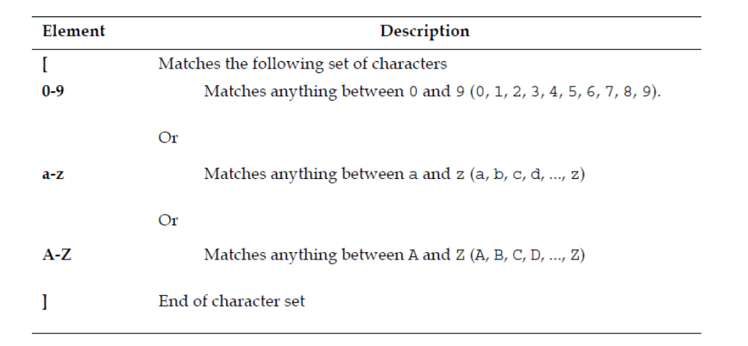
Regular Expression
Guide to Programming with Python

Slide 163
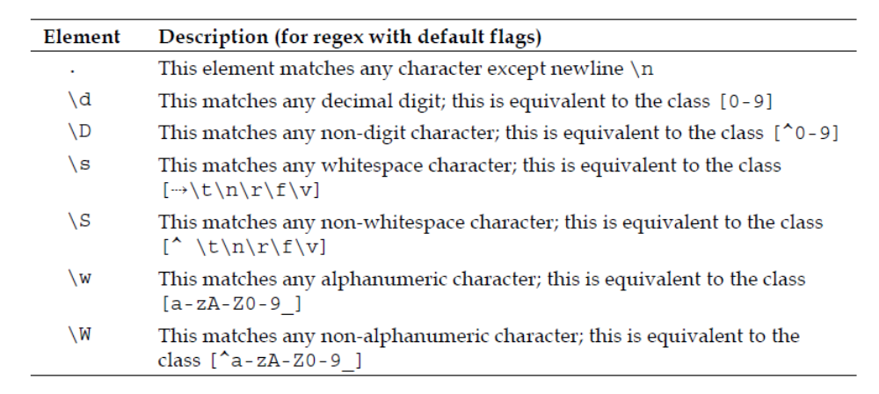
Predefined character classes
Guide to Programming with Python

Slide 164
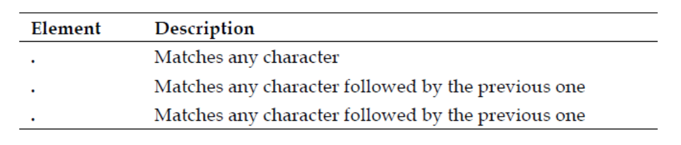
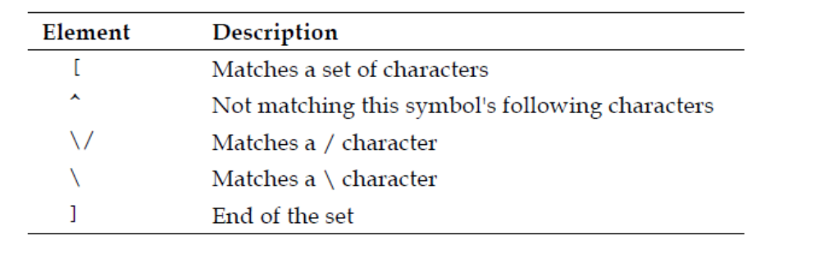
Predefined character classes
Guide to Programming with Python

Slide 165
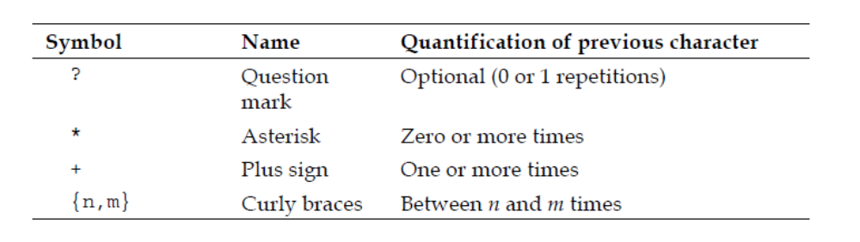
Quantifiers
Guide to Programming with Python

Slide 166
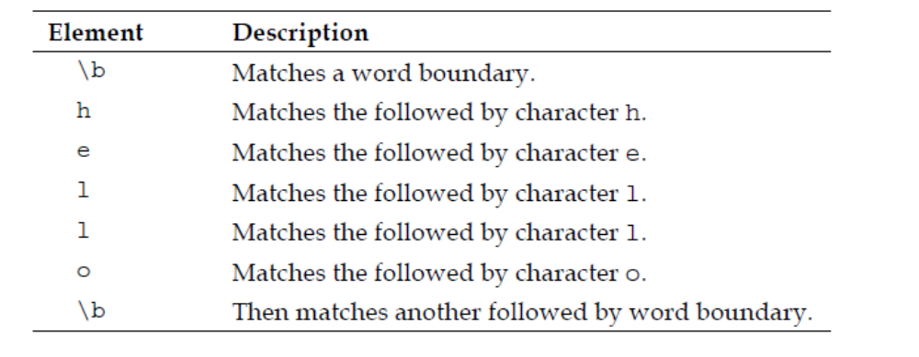
Boundary Matchers
Guide to Programming with Python

Slide 167
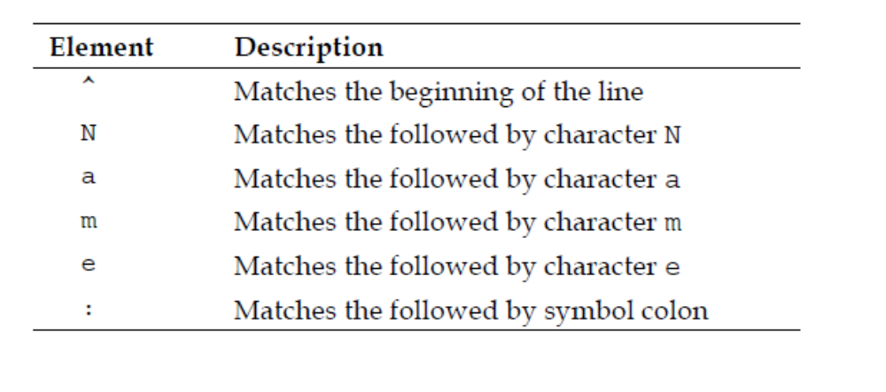
Boundary Matchers
Guide to Programming with Python

Slide 168
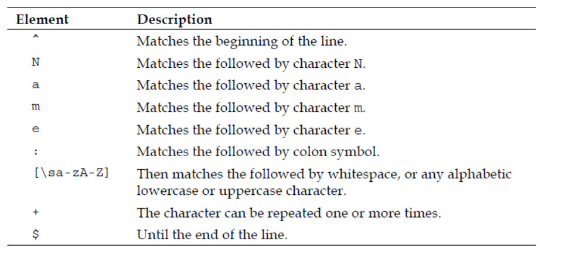
Boundary Matchers
Guide to Programming with Python

Slide 169
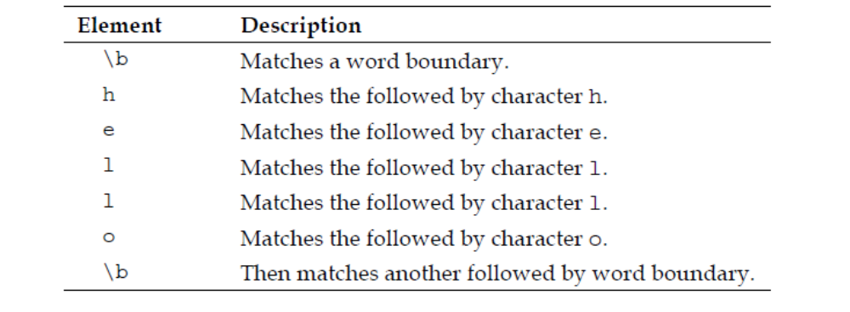
Boundary Matchers
Guide to Programming with Python

Slide 170
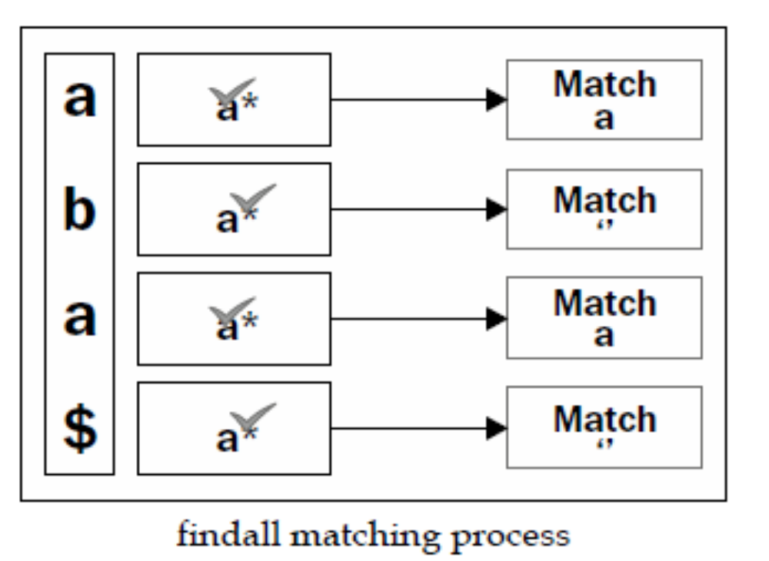
Boundary Matchers
Guide to Programming with Python

Slide 171
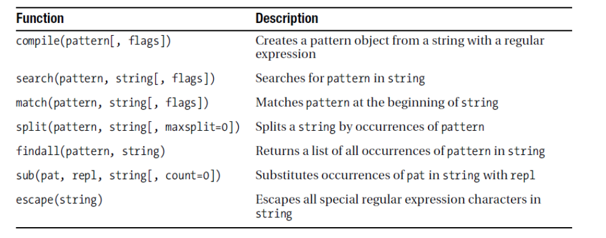
Functions
Guide to Programming with Python

Slide 172
Regular Expressions
[] | A set of characters | "[a-m]"
\ | Signals a special sequence (can also be used to escape special characters) | "\d"
. | Any character (except newline character) | "he..o"
^ | Starts with | "^hello"
$ | Ends with | "world$"
* | Zero or more occurrences | "aix*"
+ | One or more occurrences | "aix+"
{} | Excactly the specified number of occurrences | "al{2}"
| | Either or | "falls|stays"
() | Capture and group
Guide to Programming with Python

Slide 173
Regular Expressions
Character | Description | Example
\A | Returns a match if the specified characters are at the beginning of the string | "\AThe"
\b | Returns a match where the specified characters are at the beginning or at the end of a word | r"\bain" r"ain\b"
\B | Returns a match where the specified characters are present, but NOT at the beginning (or at the end) of a word | r"\Bain" r"ain\B"
\d | Returns a match where the string contains digits (numbers from 0-9) | "\d"
\D | Returns a match where the string DOES NOT contain digits | "\D"
\s | Returns a match where the string contains a white space character | "\s"
\S | Returns a match where the string DOES NOT contain a white space character | "\S"
\w | Returns a match where the string contains any word characters (characters from a to Z, digits from 0-9, and the underscore _ character) | "\w"
\W | Returns a match where the string DOES NOT contain any word characters | "\W"
\Z | Returns a match if the specified characters are at the end of the string | "Spain\Z"
Guide to Programming with Python

Slide 174
Regular Expressions
Set | Description
[arn] | Returns a match where one of the specified characters (a, r, or n) are present
[a-n] | Returns a match for any lower case character, alphabetically between a and n
[^arn] | Returns a match for any character EXCEPT a, r, and n
[0123] | Returns a match where any of the specified digits (0, 1, 2, or 3) are present
[0-9] | Returns a match for any digit between 0 and 9
[0-5][0-9] | Returns a match for any two-digit numbers from 00 and 59
[a-zA-Z] | Returns a match for any character alphabetically between a and z, lower case OR upper case
[+] | In sets, +, *, ., |, (), $,{} has no special meaning, so [+] means: return a match for any +character in the string
Guide to Programming with Python

Slide 175
Sub Process
The subprocess module allows you to spawn new processes, connect to their input/output/error pipes, and obtain their return codes.
This module intends to replace several older modules and functions:
os.system
os.spawn*
Guide to Programming with Python

Slide 176
Using Sub Process Module
The recommended approach to invoking subprocesses is to use the run() function for all use cases it can handle. For more advanced use cases, the underlying Popen interface can be used directly.
The run() function was added in Python 3.5; if you need to retain compatibility
Guide to Programming with Python

Slide 177
Using Sub Process Module
subprocess.run(args, *, stdin=None, input=None, stdout=None, stderr=None, capture_output=False, shell=False, cwd=None, timeout=None, check=False, encoding=None, errors=None, text=None, env=None, universal_newlines=None)
Guide to Programming with Python

